Slide 1

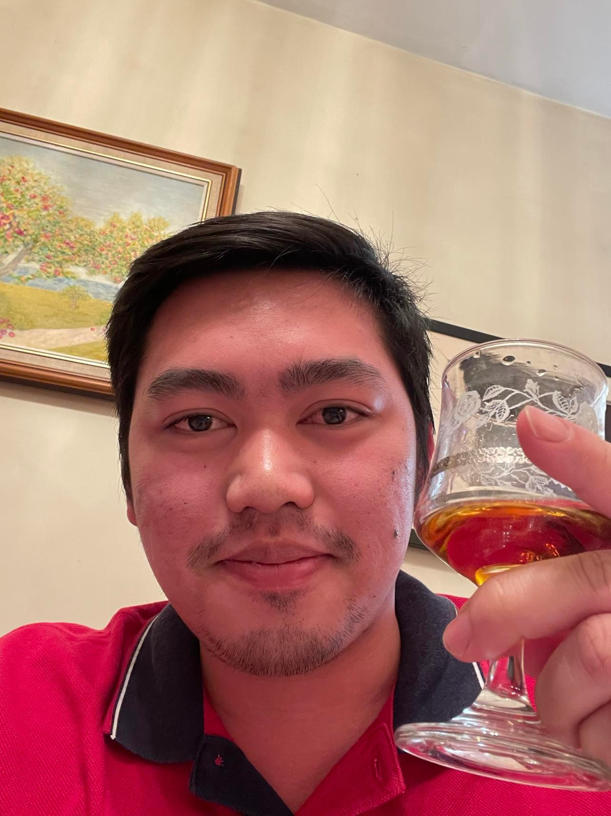
Mel Vincent Anonuevo 301167069

Slide 2
About Me
I’m 24 years old and I’m from the Philippines.
I’m currently enrolled in Software Engineering Technology (Fast Track)
I enrolled in Centennial because I want to gather knowledge about software developments and programming, and I think Centennial College offers one of the best curriculum in Toronto.

Slide 3
Projects & Interests
I currently don’t have any projects that I’m working on aside from doing labs from different subjects, but I had previous projects that I worked on when I was still working in the Philippines. One of them was a Customer Portal for a general insurance company.
My interest in software are mainly to know how to do coding because I think coding is very interesting and aside from that I really like playing games and seeing different kinds of gadgets every year.

Slide 4
The Future
I think we all know that the future will have more machineries and AIs because of the advancement of our technology each year. However, I hope that it will not result in people losing their jobs because robots can do their jobs better.
I’m seeing myself as one of the software engineers that is working very hard and enjoying my time doing what I love and passionate about.

